Slide 1
Module 2
Managing Exchange Server 2016/2019 servers
Notes:
Presentation: 60 minutes
Lab: 45 minutes
After completing this module, students will be able to:
Describe Microsoft Exchange Server 2016 management.
Describe the Exchange Server 2016 Mailbox server role.
Configure mailbox servers.
Required materials
To teach this module, you need the Microsoft PowerPoint file 20345-1A_02.pptx.
Preparation tasks
To prepare for this module, you should:
Read all of this module’s materials.
Practice performing the demonstrations and labs.
Work through the Module Review and Takeaways section to determine how you will use the information to reinforce student learning and promote knowledge transfer to on-the-job performance.
As you prepare for this class, it is imperative that you complete the labs yourself. This gives you an understanding of how the labs work and the concepts that each covers, so that you can provide meaningful hints to students who might have issues. Furthermore, it will help guide your lecture to ensure that you discuss the concepts that the labs cover.
20345-1A
2: Managing Exchange Server 2016 servers

Slide 2
Module Overview
Exchange Server 2016/2019 management Overview of the Exchange 2016/2019 Mailbox server Configuring Mailbox servers
Notes:
Provide an overview of the module.
20345-1A
2: Managing Exchange Server 2016 servers

Slide 3
Lesson 1: Exchange Server 2016/2019 management
Management tools for Exchange Server 2016/2019 Exchange admin center Demonstration: Using the Exchange Server admin center Windows PowerShell and the Exchange Management Shell Examples of Exchange Management Shell Demonstration: How to use help in the Exchange Management Shell
Notes:
Provide an overview of the lesson.
20345-1A
2: Managing Exchange Server 2016 servers

Slide 4
Management tools for Exchange Server 2016/2019
Methods for Exchange Server 2016/2019 management include:
Exchange admin center:
A graphical management environment
Accessed through a compatible web browser
Exchange Management Shell:
A command-line environment
Useful for scripting and automating Exchange management tasks
Notes:
Introduce management techniques for Exchange Server 2016. Do not go into much detail at this point, as you will discuss these topics later.
20345-1A
2: Managing Exchange Server 2016 servers

Slide 5
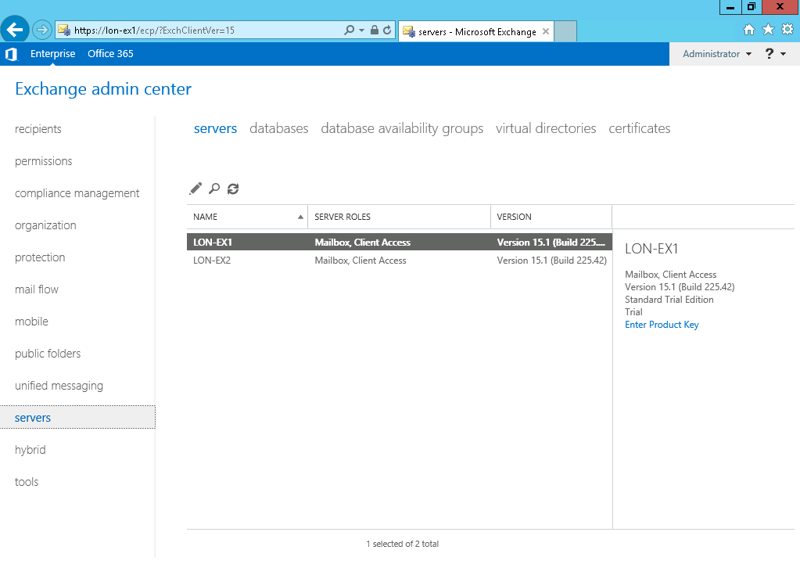
Exchange admin center
Notes:
Describe the Exchange admin center. Discuss the purpose of each node in the left pane, but do not go into technical details, as you will use these nodes for Exchange administration throughout the remainder of this course.
Note: This topic has seven additional slides, with screenshots of each group of console components, outlined with a red box, including cross-premises navigation, tabs, notification alerts, left navigation links, tool bar, list views, and the details pane.
20345-1A
2: Managing Exchange Server 2016 servers

Slide 6
Exchange admin center (2 of 8): Cross-premises navigation
Cross-premises navigation
Notes:
20345-1A
2: Managing Exchange Server 2016 servers

Slide 7
Exchange admin center (3 of 8): Left navigation links
Left navigation links
Notes:
20345-1A
2: Managing Exchange Server 2016 servers

Slide 8
Exchange admin center (4 of 8): Tabs
Tabs
Notes:
20345-1A
2: Managing Exchange Server 2016 servers

Slide 9
Exchange admin center (5 of 8): Toolbar
Toolbar
Notes:
20345-1A
2: Managing Exchange Server 2016 servers

Slide 10
Exchange admin center (6 of 8): List view
List view
Notes:
20345-1A
2: Managing Exchange Server 2016 servers

Slide 11
Exchange admin center (7 of 8): Details pane
Details pane
Notes:
20345-1A
2: Managing Exchange Server 2016 servers

Slide 12
Exchange admin center (8 of 8): Me tile and help
Me tile and help
Notes:
20345-1A
2: Managing Exchange Server 2016 servers

Slide 13
Demonstration: Using the Exchange Server admin center
In this demonstration, you will see how to use Exchange administration tools to manage Exchange Server 2016/2019
Notes:
Keep all virtual machines running for the next demonstration.
Preparation Steps
To perform this demonstration, you need to start the 20345-1A-LON-DC1 and 20345-1A-LON-EX1 virtual machines. Sign in to both virtual machines as Adatum\Administrator with the password Pa$$w0rd.
Demonstration Steps
On LON-EX1, from the Start screen, open Internet Explorer.
In the address bar, type https://LON-EX1.adatum.com/ecp, and then press Enter.
On the Exchange admin center page, sign in as Adatum\Administrator with the password Pa$$w0rd.
If prompted, in the Would you like to store your password for adatum.com dialog box, click Yes.
On the Choose your preferred display language and home time zone below page, in the Time zone list, click your time zone and click Save.
Review the options in the Exchange admin center.
In the Exchange admin center console, click recipients in the left pane, and then click mailboxes in the central pane.
Click the + sign, and then click User mailbox.
In the new user mailbox window, select Existing user, and then click Browse.
In the Select User – Entire Forest window, select Aidan Delaney, and then click OK.
In the Alias text box, type AidanD, and then click Save.
Make sure that Aidan Delaney appears in the list of mailboxes.
20345-1A
2: Managing Exchange Server 2016 servers

Slide 14
Windows PowerShell and the Exchange Management Shell
Exchange Management Shell is a command-line interface for administering Exchange Server 2016/2019
Exchange Management Shell includes the following features:
Provides several hundred cmdlets for Exchange Server 2016/2019 administration
Offers an extensible scripting engine
Applies RBAC permissions
Notes:
Lead a class discussion about Exchange Management Shell. Discuss how Exchange Management Shell and Exchange Management Console run on Windows PowerShell 3.0, and how Exchange Management Shell uses the Windows PowerShell remoting feature.
Mention that cmdlets are typically designed around a repetitive administrative task, and that Exchange Management Shell provides more than 700 cmdlets for Exchange Server-specific management tasks. These cmdlets are in addition to the non-Exchange Server system cmdlets included in the basic Windows PowerShell shell design.
Ensure that the students understand that Windows PowerShell is more than just a command-line interface; it also provides a comprehensive scripting engine that you can automate with programs.
20345-1A
2: Managing Exchange Server 2016 servers

Slide 15
Examples of Exchange Management Shell
Enable-Mailbox -Identity adatum\Bart
New-MailboxExportRequest -Mailbox Bart -FilePath \\LON-EX1\PSTFileShare\Bart_Mailbox.pst
Get-MailboxStatistics -Database MailboxDatabase
New-MailboxDatabase -Name MailboxDatabase -Server LON-Ex1
Get-ExchangeServer -Status | Format-List
New-DynamicDistributionGroup -Name DDG -Alias DDGAlias -OrganizationalUnit OU -IncludedRecipients MailboxUsers
New-MoveRequest -Identity 'user1'-TargetDatabase Executives
Notes:
20345-1A
2: Managing Exchange Server 2016 servers

Slide 16
Demonstration: How to use help in the Exchange Management Shell
In this demonstration, you will see how to use the built-in help functionality of Exchange Management Shell
Notes:
Keep all virtual machines running for the next demonstration.
Preparation Steps
To perform this demonstration, you need to have the 20345-1A-LON-DC1 and 20345-1A-LON-EX1 virtual machines (VMs) running. Sign in to both virtual machines as Adatum\Administrator with the password Pa$$w0rd. These VMs should already be in an active state after the completion of the previous demonstration.
Demonstration Steps
On LON-EX1, click the Exchange Management Shell icon on the taskbar.
In the Exchange Management Shell window, type the following command, and then press Enter to display a list of Exchange cmdlets:
Get-ExCommand | more
Use the spacebar to page through the list of Exchange-related cmdlets.
In the Exchange Management Shell window, type the following command, and then press Enter to view all of the Mailbox-related cmdlets:
Get-Command -noun Mailbox
In the Exchange Management Shell window, type the following command, and then press Enter to view information about the Enable-Mailbox cmdlet:
Help Enable-Mailbox | more
Use the spacebar to page through the help information on the Enable-Mailbox cmdlet.
In the Exchange Management Shell window, type the following command, and then press Enter to view information about the Enable-Mailbox cmdlet:
Get-Help Enable-Mailbox -examples | more
20345-1A
2: Managing Exchange Server 2016 servers
(More notes on the next slide)

Slide 17
Lesson 2: Overview of the Exchange 2019 Mailbox server
The Mailbox server role in Exchange Server Interaction of the role services and components in Mailbox server Mailbox databases in Exchange Server How mailbox databases are updated Database log considerations Storage options for the Exchange Server 2016 Mailbox server role
Storage options for the Exchange Server 2019 Mailbox server role
Notes:
20345-1A
2: Managing Exchange Server 2016 servers

Slide 18
The Mailbox server role in Exchange Server
In Exchange Server 2016, the Mailbox server role provides:
Hosting for mailbox databases
Hosting for public folder mailboxes
Transport and message routing services:
Hub Transport service
Mailbox Transport services
UM service
High-availability services
Exchange Server 2019 provides the same functionalities except for the UM service
Notes:
Describe the role of the Mailbox server in Exchange Server 2016. It is very important that you emphasize that the Client Access, Hub Transport, and Unified Messaging server roles are now integrated within the Mailbox server.
20345-1A
2: Managing Exchange Server 2016 servers

Slide 19
Mailbox databases in Exchange Server
Mailbox stores in Exchange Server consist of following files:
Mailbox database (.edb file)
Transaction log (.log file)
Checkpoint file (.chk)
Temporary file (Tmp.edb)
Reserve log files (E##res0001.jrs - E##res000A.log per database, where ## is the log prefix)
Administrators rarely interact directly with these files, except during backup and restore procedures
Notes:
Describe the mailbox store in Exchange Server 2016. Introduce the files that make up the Exchange Server mailbox store. Explain the purpose of each file.
20345-1A
2: Managing Exchange Server 2016 servers

Slide 20







How mailbox databases are updated
1.
4.
Write to the database
Receive a message
3.
Update
Write message
5.
2.
Memory cache
Transaction log
Client access
Notes:
Discuss the process that the Mailbox server uses when it receives data, as follows:
The Mailbox server receives the message.
The Mailbox server writes the message to the current transaction log and memory cache simultaneously.
Note: If the current transaction log reaches 1 megabyte (MB) of storage, Exchange Server 2016 renames it and creates a new current transaction log.
The Mailbox server writes the transaction from memory cache to the appropriate database.
The Mailbox server updates the checkpoint file to indicate that the transaction was committed successfully to the database.
Clients can access and read the message in the database.
If time permits, identify the files from the previous slide that each step of this process affects.
20345-1A
2: Managing Exchange Server 2016 servers

Slide 21
Database log considerations
Each change performed in a mailbox database must be logged in the transaction log file before it is committed to the database
Each transaction log file is 1 MB in size
Transaction log files are not deleted automatically
Circular logging can be used, but it is not recommended
Follow these guidelines for log files:
Regularly perform Exchange Server backups (non-ndp only)
Move transaction logs to a dedicated drive (does not apply if you are using DAGs)
Place transaction log files on a redundant disk array (non-ndp only)
Ensure enough free disk space is available on the log disk
Do not use compression on the volume with the logs
Notes:
Discuss transaction log files. Explain why these files are important, and describe their role in backup and restore procedures. In addition, explain what circular logging is, and why we do not recommend using it.
20345-1A
2: Managing Exchange Server 2016 servers

Slide 22
Storage options for the Exchange Server 2016 Mailbox server role
Disk storage options:
DAS
SAN
RAID options:
RAID 0 ― Striping
RAID 1 ― Mirroring
RAID 5 ― Striping with parity
RAID 0+1 ― Mirrored striped sets
RAID 6 ― Striping with double parity
RAID 1+0 or RAID 10 ― Mirrored sets in a striped set
JBOD
Notes:
Lead a discussion about disk storage options and about redundant array of independent disks (RAID) technologies. The students should understand the general advantages and disadvantages of each major technology. The basic concepts are the same across all implementations of these technologies.
Stress that because the Exchange Server 2016 disk I/O requirements are lower than in previous Exchange Server versions, more storage options are available. Explain that an organization should ensure that the storage option it selects meets its business and technical requirements for the Exchange Server deployment. Tools are available to approximate usage patterns, such as Load Simulator and Jetstress. Explain that you can use these tools to test the suitability of various hardware configurations in your environment.
20345-1A
2: Managing Exchange Server 2016 servers

Slide 23
Storage options for the Exchange Server 2019 Mailbox server role
Storage options for Exchange Server 2019 are basically the same as for Exchange Server 2016
However, in Exchange Server 2019 support for tiered storage was added
Allows the use of SSDs for fast retrieval of mailbox metadata
Only supported in a DAG environment with autoreseed enabled
Notes:
Lead a discussion about disk storage options and about redundant array of independent disks (RAID) technologies. The students should understand the general advantages and disadvantages of each major technology. The basic concepts are the same across all implementations of these technologies.
Stress that because the Exchange Server 2016 disk I/O requirements are lower than in previous Exchange Server versions, more storage options are available. Explain that an organization should ensure that the storage option it selects meets its business and technical requirements for the Exchange Server deployment. Tools are available to approximate usage patterns, such as Load Simulator and Jetstress. Explain that you can use these tools to test the suitability of various hardware configurations in your environment.
20345-1A
2: Managing Exchange Server 2016 servers

Slide 24
Exchange Server 2019 Meta Cached Database
Metadata of mailboxes is promoted to an additional Database (Meta Cache DB)
The Meta Cache DB (MCDB) is placed on fast SSD storage
Improves logon to exchange server for users
Fast retrieval of small items
If MCDB is unavailable, data is provided from “normal” DB

Slide 25
Lesson 3: Configuring Mailbox servers
Initial Mailbox server configuration tasks
Configuring storage for Exchange Server
Creating and managing mailbox databases and logs
Demonstration: Creating and managing mailbox databases
Notes:
Provide an overview of the lesson.
20345-1A
2: Managing Exchange Server 2016 servers

Slide 26
Initial Mailbox server configuration tasks
Before you put your Exchange 2016/2019 Mailbox server into production, perform the following tasks:
Secure the server
Create and configure the databases
Configure high availability
Configure the public folders
Configure the recipients, including resource mailboxes
Configure the offline address book
Implement an antivirus solution
Notes:
Discuss the tasks that you should perform before you put your Mailbox server into production, or before you migrate your data to it.
20345-1A
2: Managing Exchange Server 2016 servers

Slide 27
Creating and managing mailbox databases and logs
You can create and manage mailbox databases by using the Exchange admin center or Exchange Management Shell
You use the Exchange admin center is used for basic management
You use the Exchange Management Shell is used for advanced mailbox database management
You cannot use the Exchange admin center to move mailbox databases
Useful Exchange Management Shell cmdlets include:
New-MailboxDatabase
Get-MailboxDatabase
Set-MailboxDatabase
Move-DatabasePath
Notes:
Explain how you can create and manage mailbox databases in the Exchange admin center and in the Exchange Management Shell. Emphasize that you cannot perform advanced configuration and management in the Exchange admin center. Describe the purpose of the most important cmdlets that you use for Mailbox server management.
20345-1A
2: Managing Exchange Server 2016 servers

Slide 28
Demonstration: Creating and managing mailbox databases
In this demonstration, you will see how to create and manage mailbox databases
Notes:
Please revert all virtual machines after you have completed this demonstration.
Preparation Steps
To perform this demonstration, you need to start the 20345-1A-LON-DC1 and 20345-1A-LON-EX1 virtual machines. These should be running from the previous demonstration. Ensure that you are signed in to the virtual machines as Adatum\Administrator with the password Pa$$w0rd.
Demonstration Steps
On LON-EX1, in Server Manager, click Tools, and then click Computer Management.
If necessary, expand Storage, and then click Disk Management.
Right-click Disk 1, and then click Online.
Right-click Disk 1, and then click Initialize disk. In the Initialize Disk dialog box, click OK.
Right-click the unallocated space next to Disk 1, and then click New Simple Volume.
On the Welcome to the New Simple Volume Wizard page, click Next.
On the Specify Volume Size page, click Next.
On the Assign Drive Letter or Path page, click Next.
On the Format Partition page, in the Volume Label box, type DB2. Select the Perform a quick format check box, and then click Next.
Click Finish. (Note: If the Microsoft Windows window pops up with a prompt to format the disk, click Cancel.)
Repeat steps 3 through 10 for Disk 2. (Note: Use Logs for Volume Label). Close the Computer Management window.
Switch to the Exchange Admin Center in Internet Explorer.
Click servers in the feature pane, and then click the databases tab.
20345-1A
2: Managing Exchange Server 2016 servers
(More notes on the next slide)

Slide 29
LAB 2: Datenbanken

